Slide 1
Video-feed access from DJI X3 camera
Pavan

Slide 2
Real Time Messaging Protocol (RTMP)
TCP-based streaming protocol.
High-performance transmission multimedia data across network.
Multimedia Data
Server
Client
RTMP

Slide 3
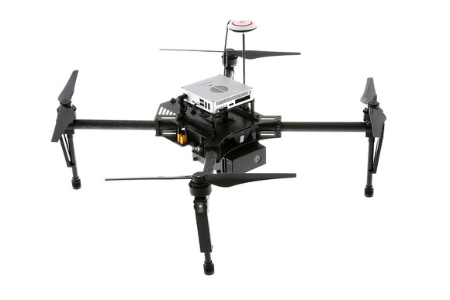

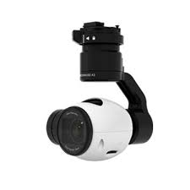
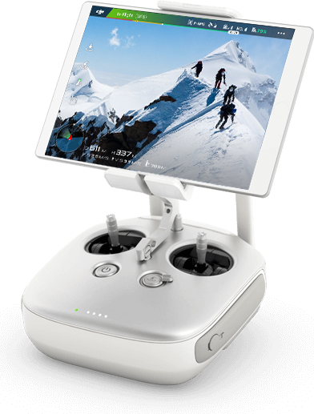
SSH
RMTP
Broadcast Live Video

Slide 4
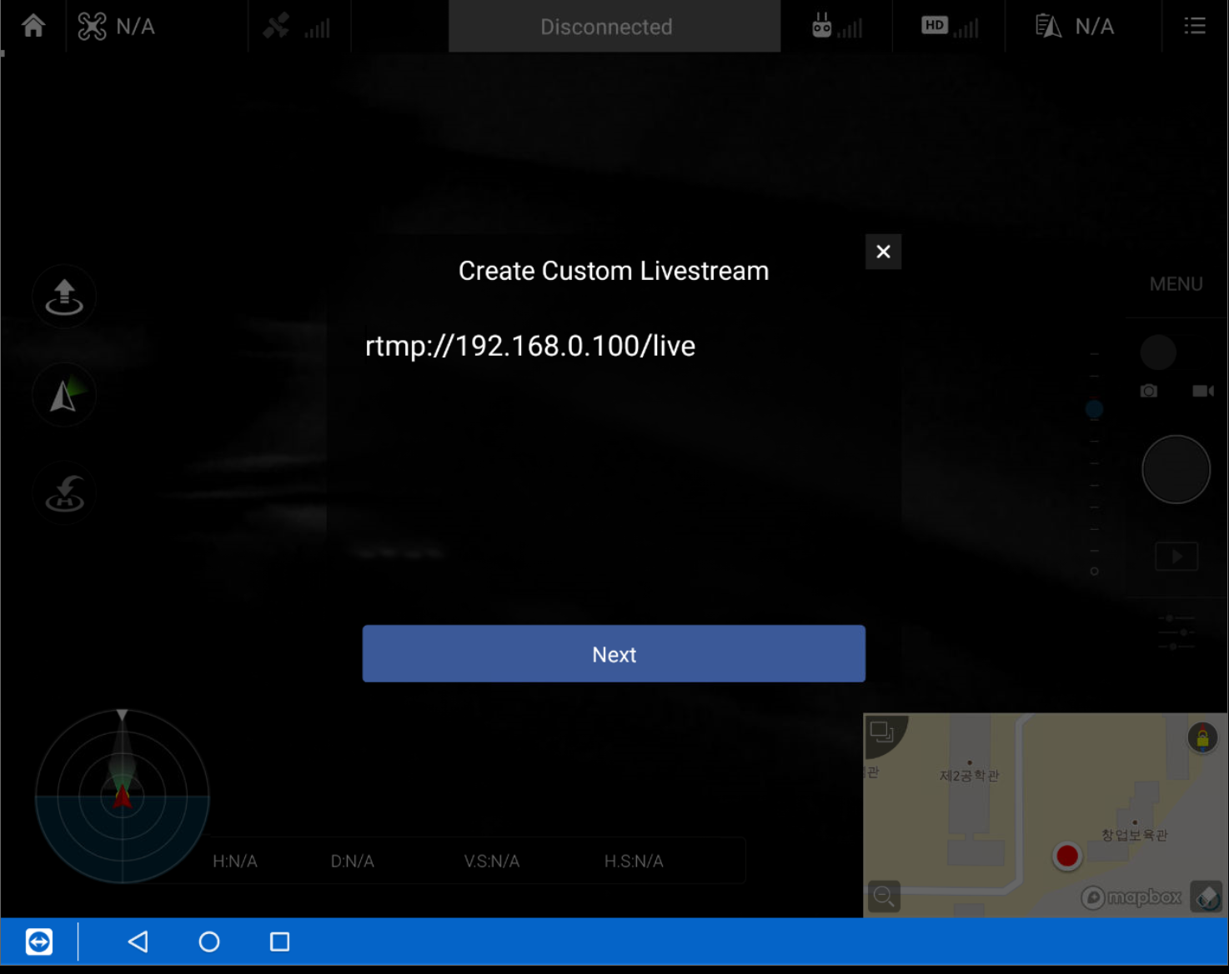
SSH
RMTP
Broadcast Live Video
In DJI Go App

Slide 5
Nginx
OBS
SSH
RMTP
Nginx - Receives the video stream.
OBS - Captures and encodes video on a Local Computer
Broadcast Live Video

Slide 6

SSH
RMTP
Broadcast Live Video

Slide 7
1. https://www.youtube.com/watch?v=tsG93JD0YOc - Here instead of youtube, you need to select custom RTMP option, (something like this rtmp://192.0.0.131/live, this will be a host computer ip address).
2. Setup Nginx and Nginx-RTMP server. (https://obsproject.com/forum/resources/how-to-set-up-your-own-private-rtmp-server-using-nginx.50/)
3. Use any player (ex VLC) and join to the network (rtmp://192.0.0.131/live) to see UAV video-feed.

